Slide 1
Managing your SDLC using the Atlassian Suite An introduction to common integration points and why they are useful
Twitter: @dkcwd

Slide 2
So many useful integrations but first....

Slide 3
Purpose of the session
During the June 2016 Sydney Atlassian DevOps meetup there was a request from group members to explain common integration points between tools with examples.
There is plenty of information available online explaining ”how” to update configuration and link tools within the Atlassian Suite together.
This session will focus on a subset of the Atlassian tools available and provide an opinionated view on “why” the integration points demonstrated add value for teams during the SDLC of an application.
The session should:
provide some context for the integration ecosystem for Atlassian tools
encourage you to make your usage of the tools more enjoyable and/or productive

Slide 4
The tools we’ll talk about in this session
1. Confluence as source of truth for user stories, meeting notes and product decisions
2. JIRA for managing all tasks related to user stories as part of the SDLC
3. Bitbucket for managing version control of application code
4. Bamboo for automating the building, testing and deployment of application code
5. HipChat for enabling discussion around all of the above and triggering custom actions

Slide 5
Let’s keep in mind….
The examples in this session are opinionated for the purpose of explaining why the tools can add value during the SDLC.
You may prefer a different approach and if so this session is a good place to share methodology and automation tips.
Some attendees may be less familiar with core features of the Atlassian Suite than you are, feel free to share your knowledge with them when it seems appropriate.

Slide 6
An opinionated example using Confluence....

Slide 7
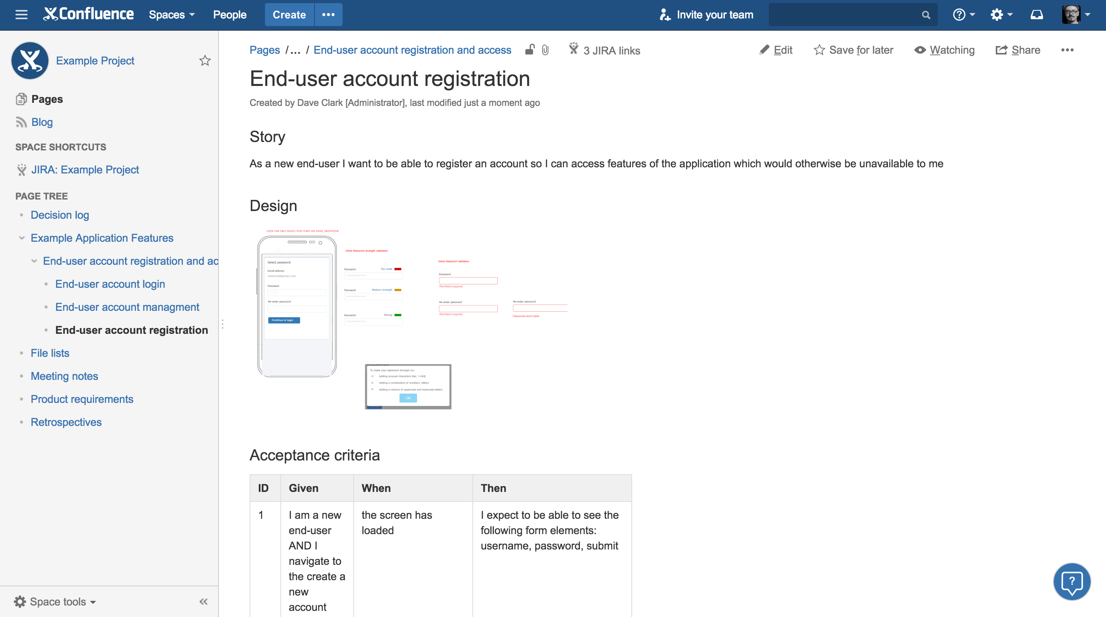
Confluence and JIRA
There are plenty of ways you can use Confluence as a source of truth for application features and product decisions. The template shown here is a custom one which was created for this session using the Confluence “Space tools” template designer
In this custom template, details including all applicable designs, acceptance criteria and field validation are captured for each story. Let’s scroll down and see where a JIRA integration is involved on the page.

Slide 8
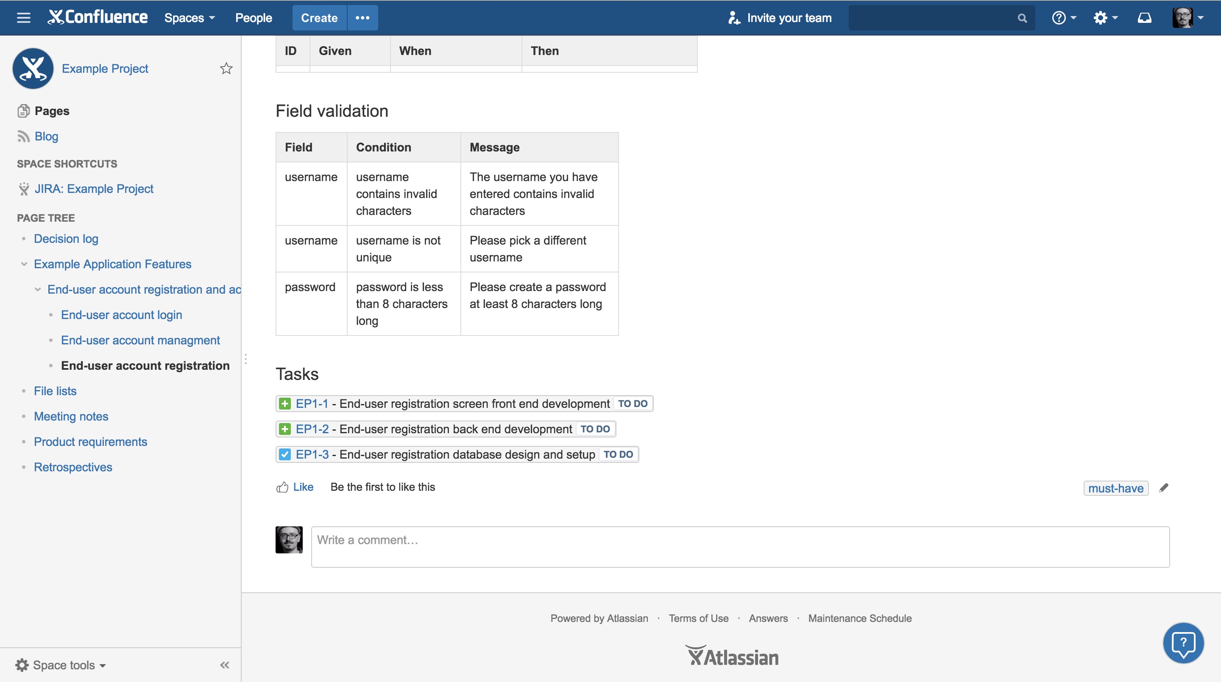
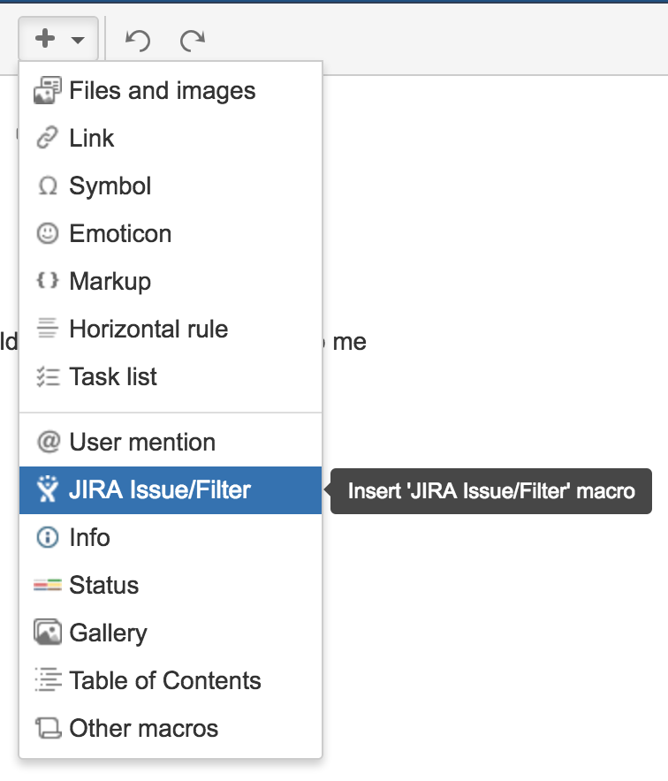
Confluence and JIRA
The “+” symbol reveals a dropdown option to allow you to create/search for issues to include
When we edit the page it is possible to create and display new JIRA tickets as well as display existing one by using the option to “insert” them in the page.

Slide 9
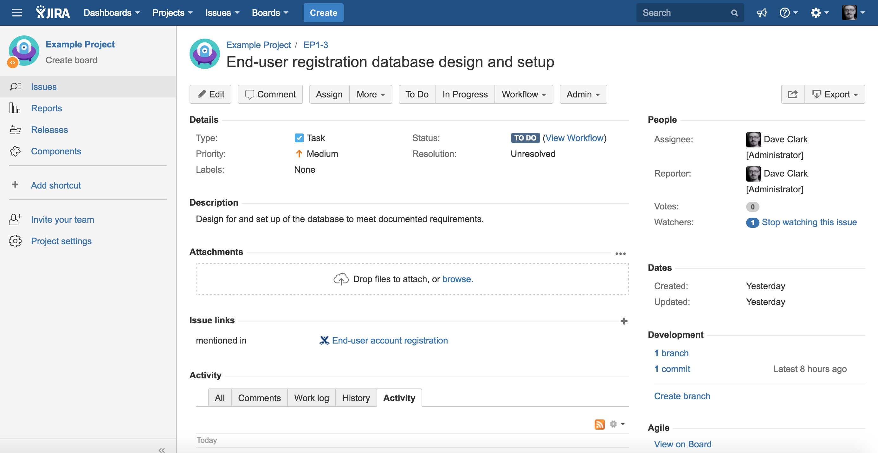
Confluence and JIRA
Where the ticket has been mentioned in a Confluence document, it should be reflected in the “Issue links” section

Slide 10
Bitbucket and JIRA
You can view branches and commits which have been made as well as create a new branch for the current ticket

Slide 11
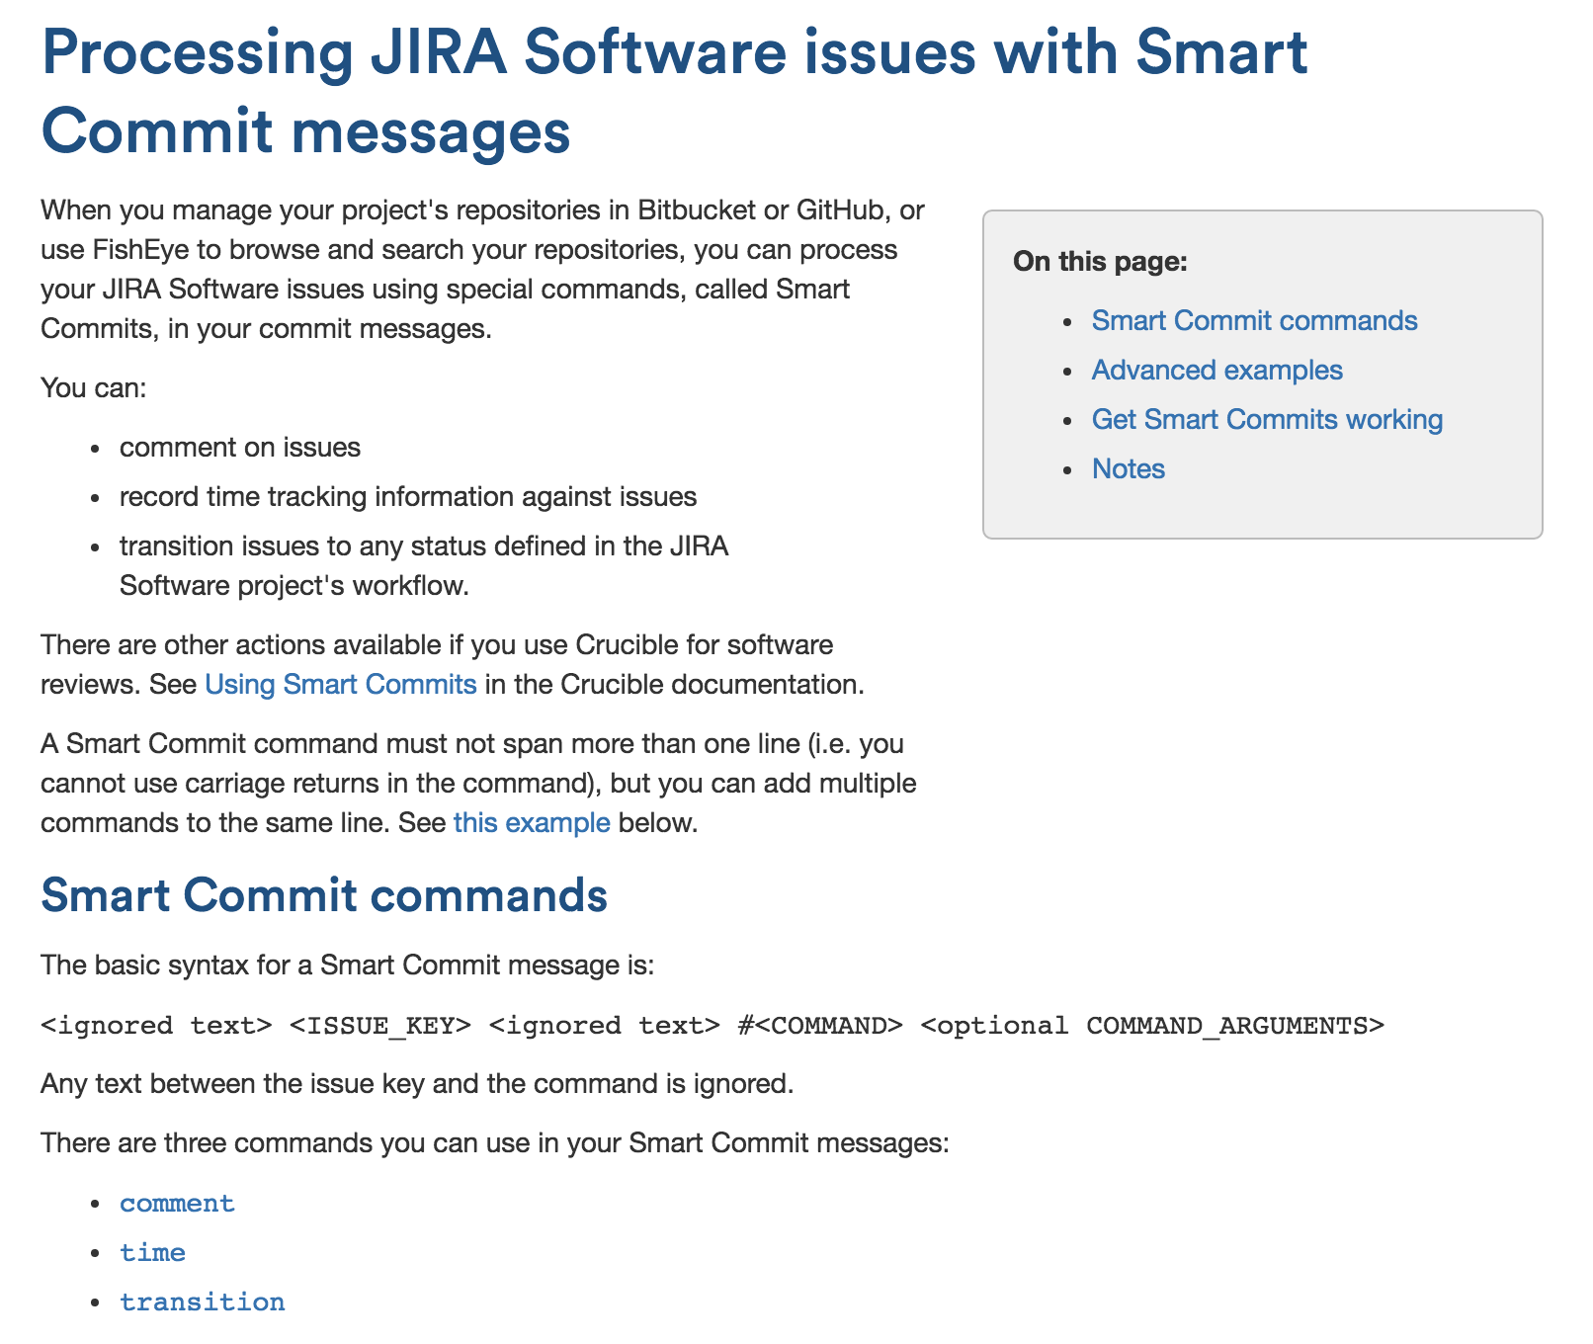
Bitbucket and JIRA
For configuration see: https://confluence.atlassian.com/bitbucket/processing-jira-software-issues-with-smart-commit-messages-298979931.html
The way you enable this integration is through a combination of configuration and ”smart commits” syntax

Slide 12
Bitbucket and JIRA
If we wanted to create a new branch to carry out the work required we can use the link here.

Slide 13
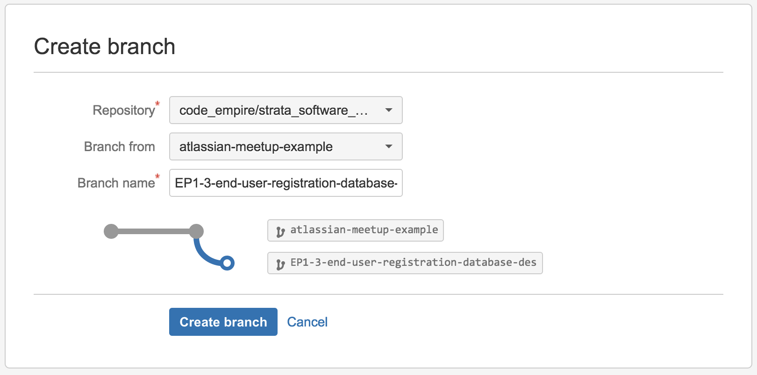
Bitbucket and JIRA
Creating a new branch for the ticket EP1-3 from another branch….

Slide 14
So what about building, testing and deploying?

Slide 15
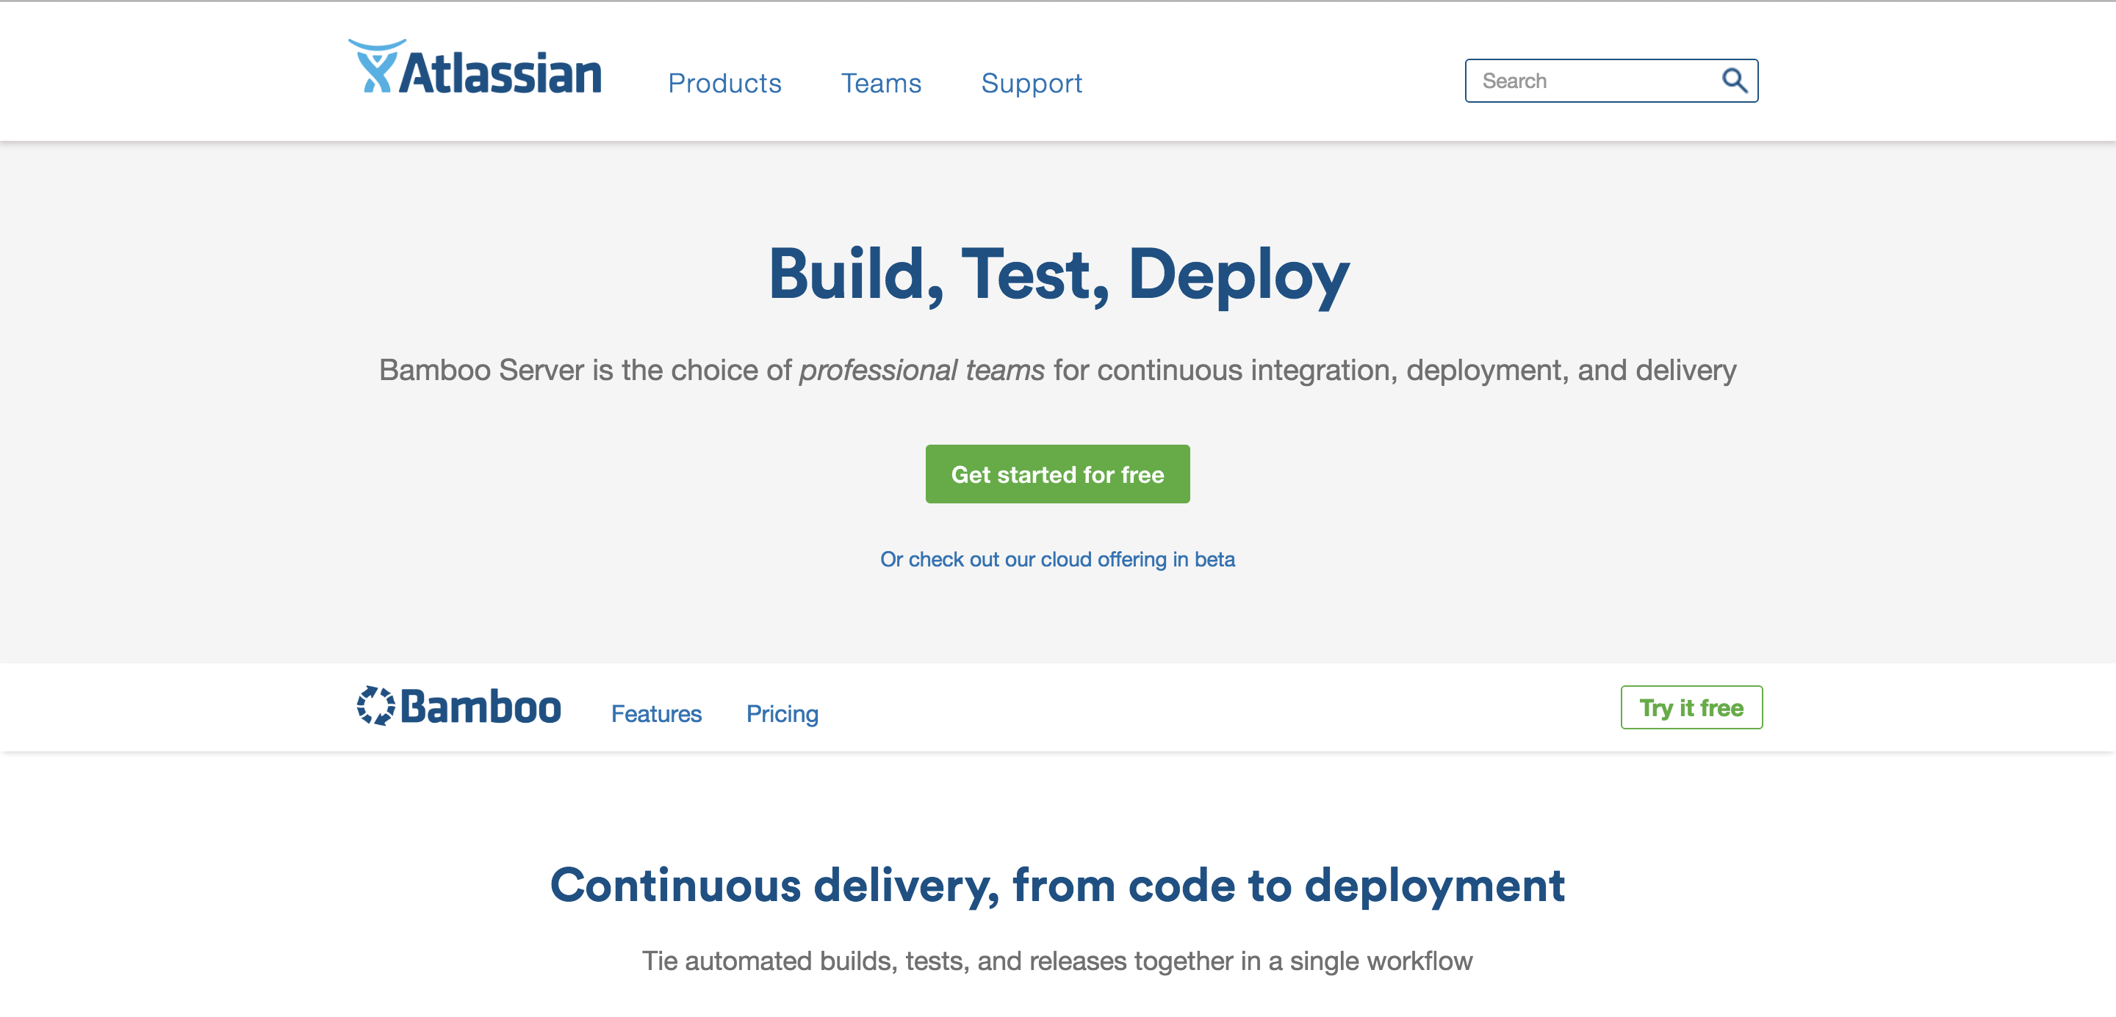
Introducing Bamboo
Always nice to get started with a free 30 day trial….

Slide 16
So hang on…what does Bamboo do?
It’s helps you to automate the build, test and deployment of your application.
The automation within Bamboo may be some of the most important automation you contribute to the SDLC. Aim to reuse existing scripts where they are already abstract enough.
You need to do some work to set it up which you’ll see shortly.
Note: There may be some new terminology coming up for some attendees so the next few slides will explain Build, Test and Deploy in more detail.

Slide 17
Build, Test, Deploy
Build
Most front end application clients are composed from a variety of files and rely on assets such as images, JavaScript, CSS.
A build process will typically involve creating an ”artefact”.
An “artefact” could be a .zip file containing an optimized version of the application.
It could also be one of more files which will be useful for a more complex process.

Slide 18
Build, Test, Deploy
Test
In this step the ”artefact” may be tested using one or more appropriate test methodolgies.
If the tests pass then this should mean the artefact is “deployable”.
Note that there may be a number of additional steps which you may need to go through to verify whether the artefact is actually “deployable” and once you are aware of those steps the next step could be to automate them!

Slide 19
Build, Test, Deploy
Deploy
In this step the tested ”artefact” is deployed using an appropriate strategy.
If the deployment process fails for any reason, ideally it will be easy to “roll back” until another attempt can be made.
If you are already familiar with these concepts then you should find it relatively easy to begin working with Bamboo following the documentation.

Slide 20
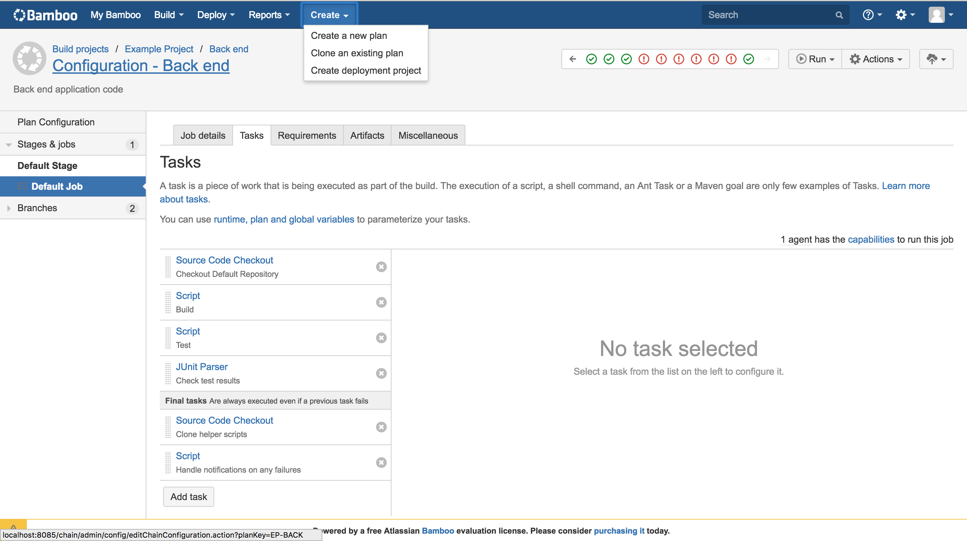
New build plans
There are options to create a new plan from scratch or clone one.

Slide 21
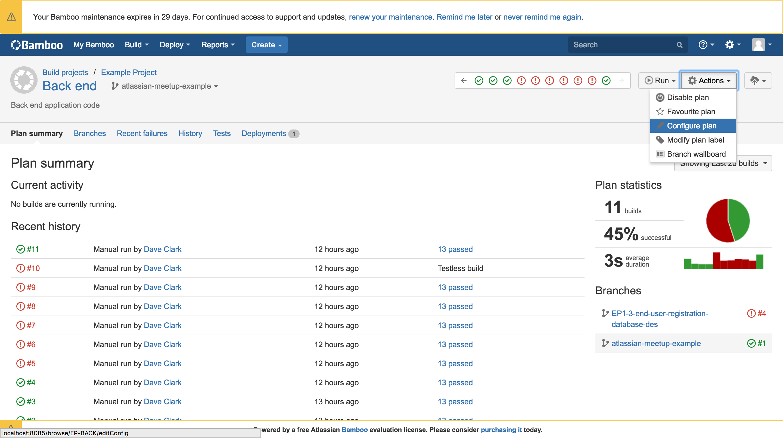
Making changes to a build plan
To edit a plan you will need to select “Configure plan”….

Slide 22
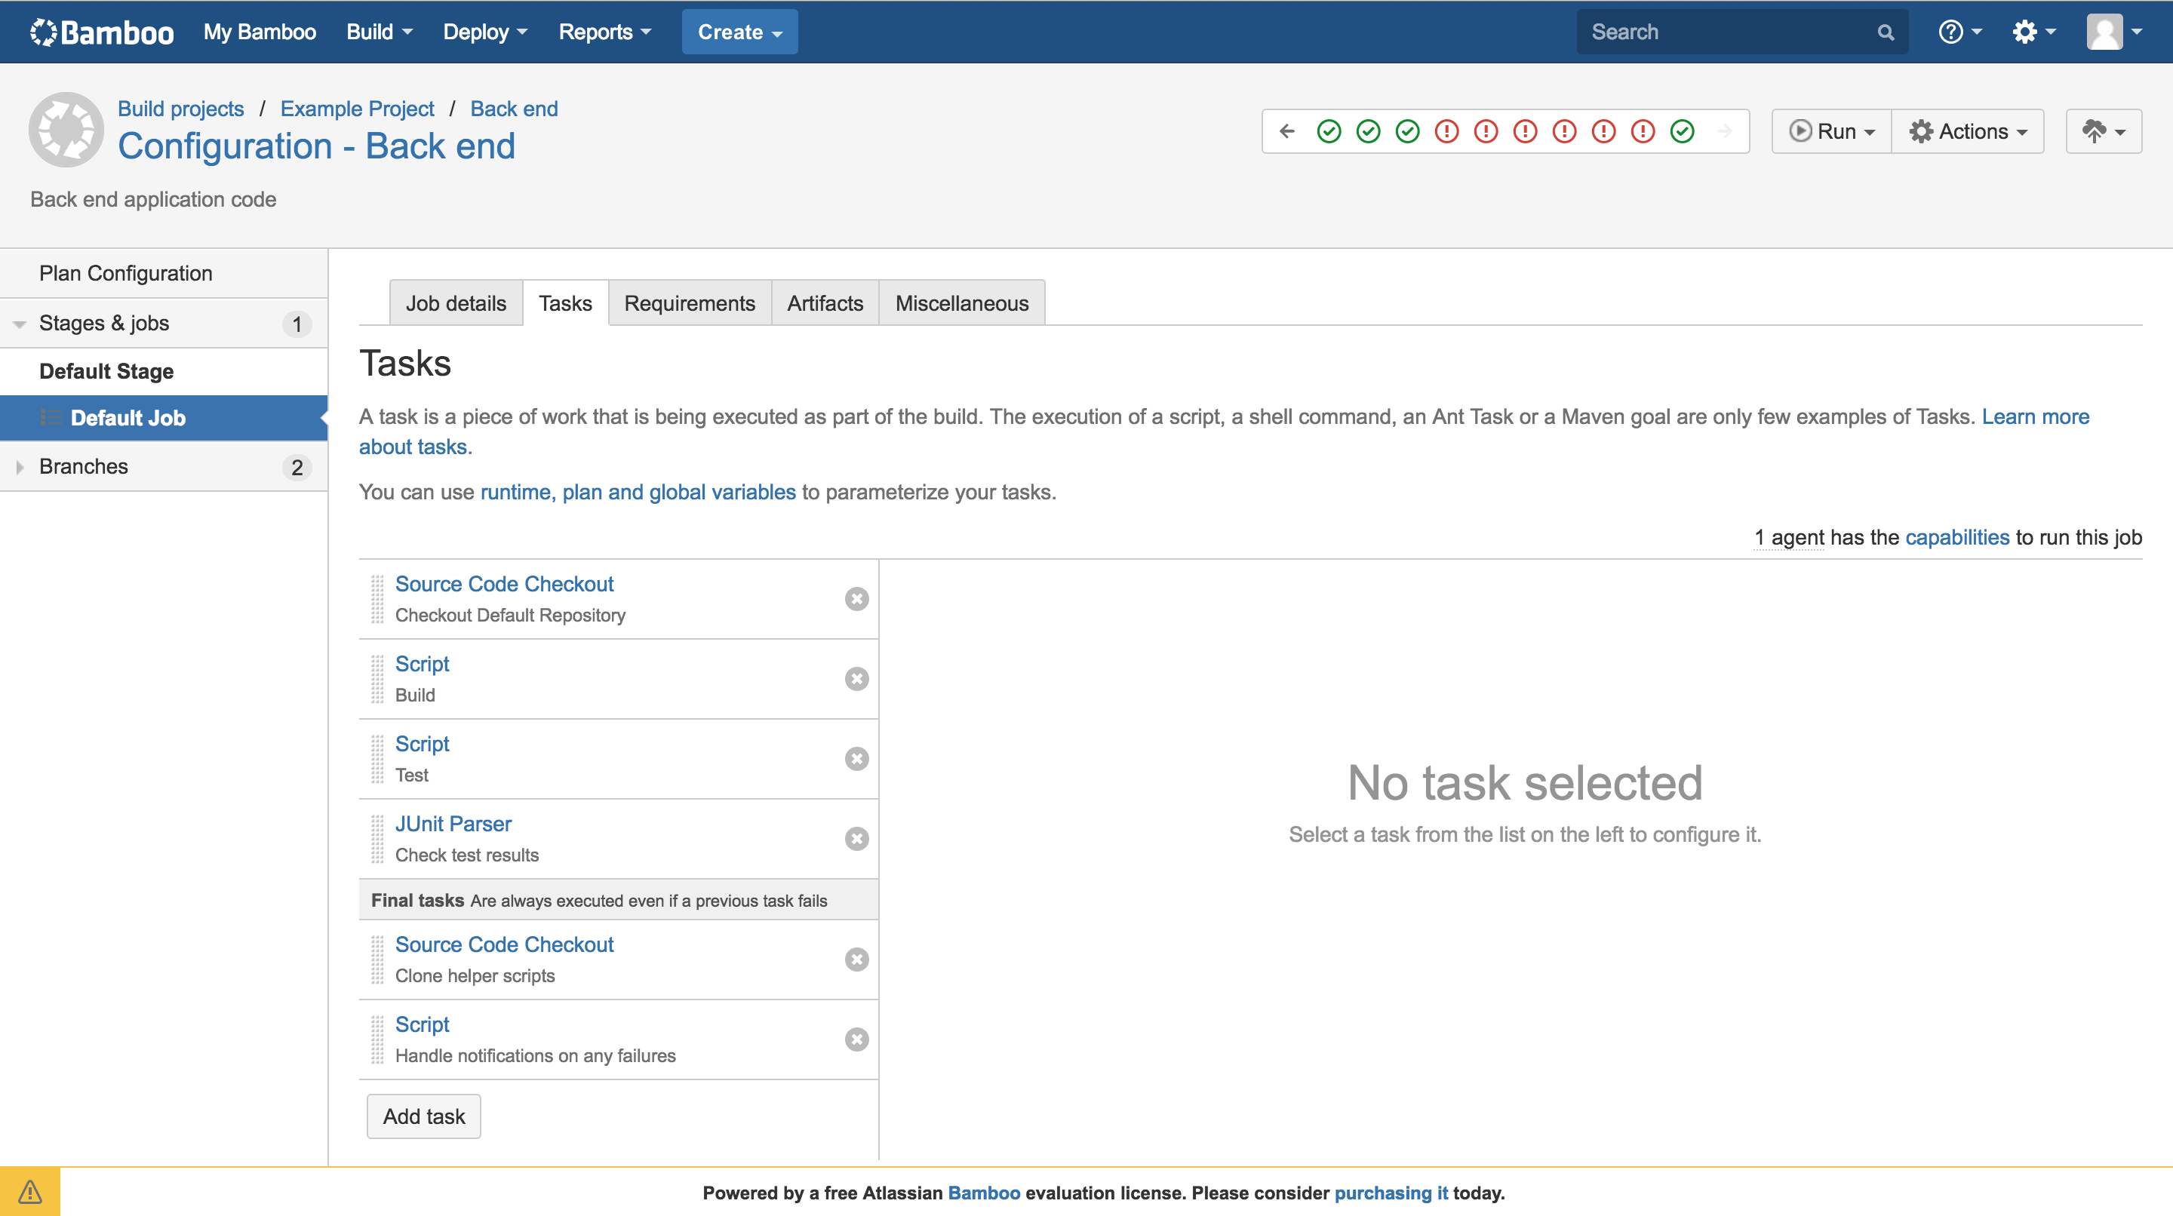
Configuring tasks related to a build
Each step can be configured using widgets or inline scripts….

Slide 23
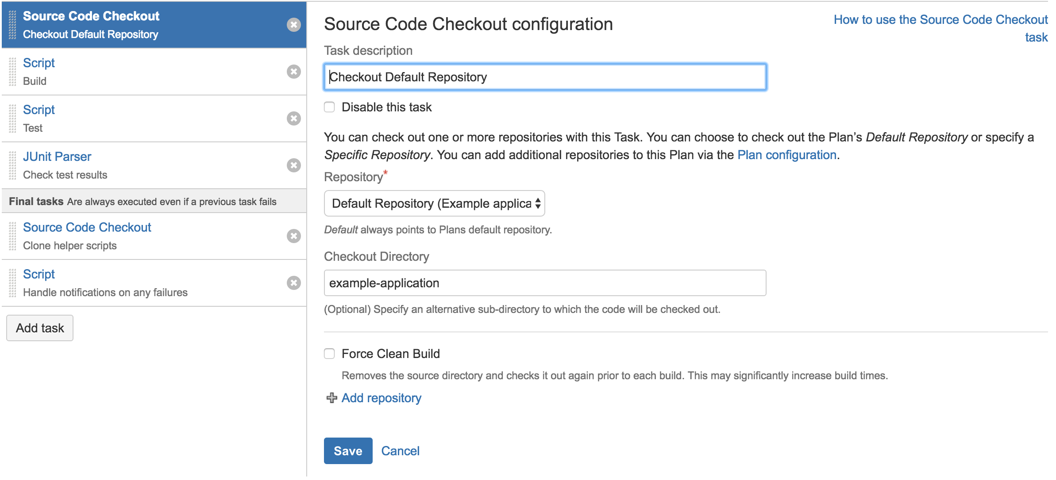
Configuring tasks related to a build
*If checking out multiple repositories use a specific “Checkout Directory”
* Why? Because it makes it easier to use inline scripts such as: cd example-application/stack/php-api/src/ && php composer.phar install –vvv

Slide 24
Ok so what about notifications?

Slide 25
And now HipChat brings it together….

Slide 26
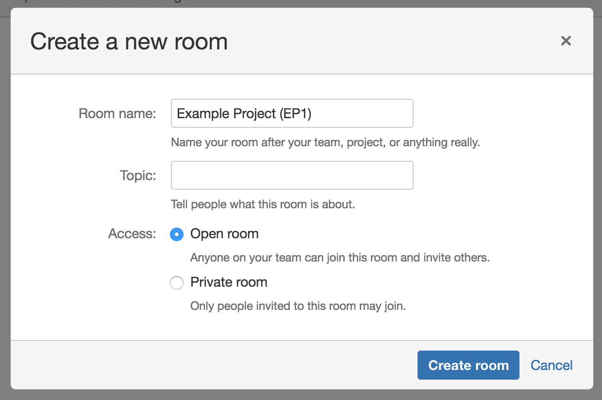
HipChat and JIRA
Create a new HipChat room for the Example Project….

Slide 27
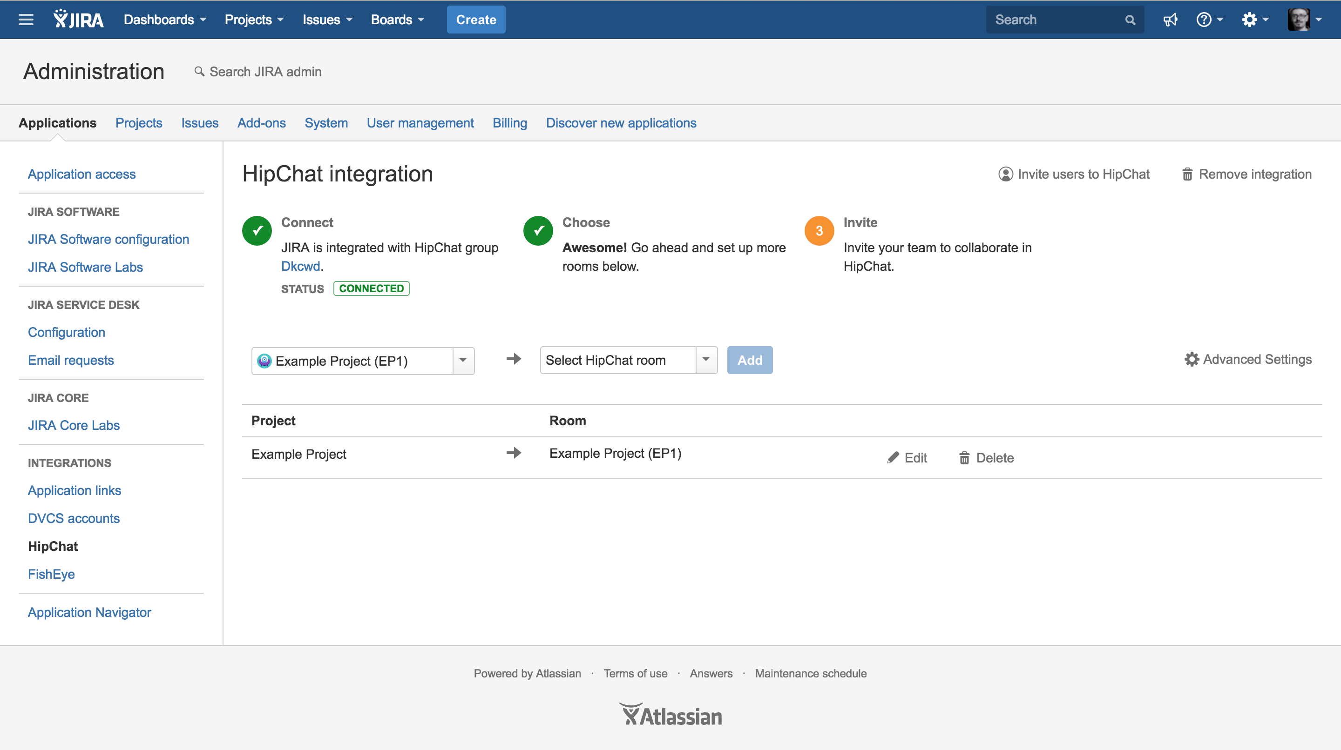
HipChat and JIRA
Following the steps in the integration wizard makes it easy to link specific projects to HipChat rooms enabling users to find and discuss tickets with minimal effort

Slide 28
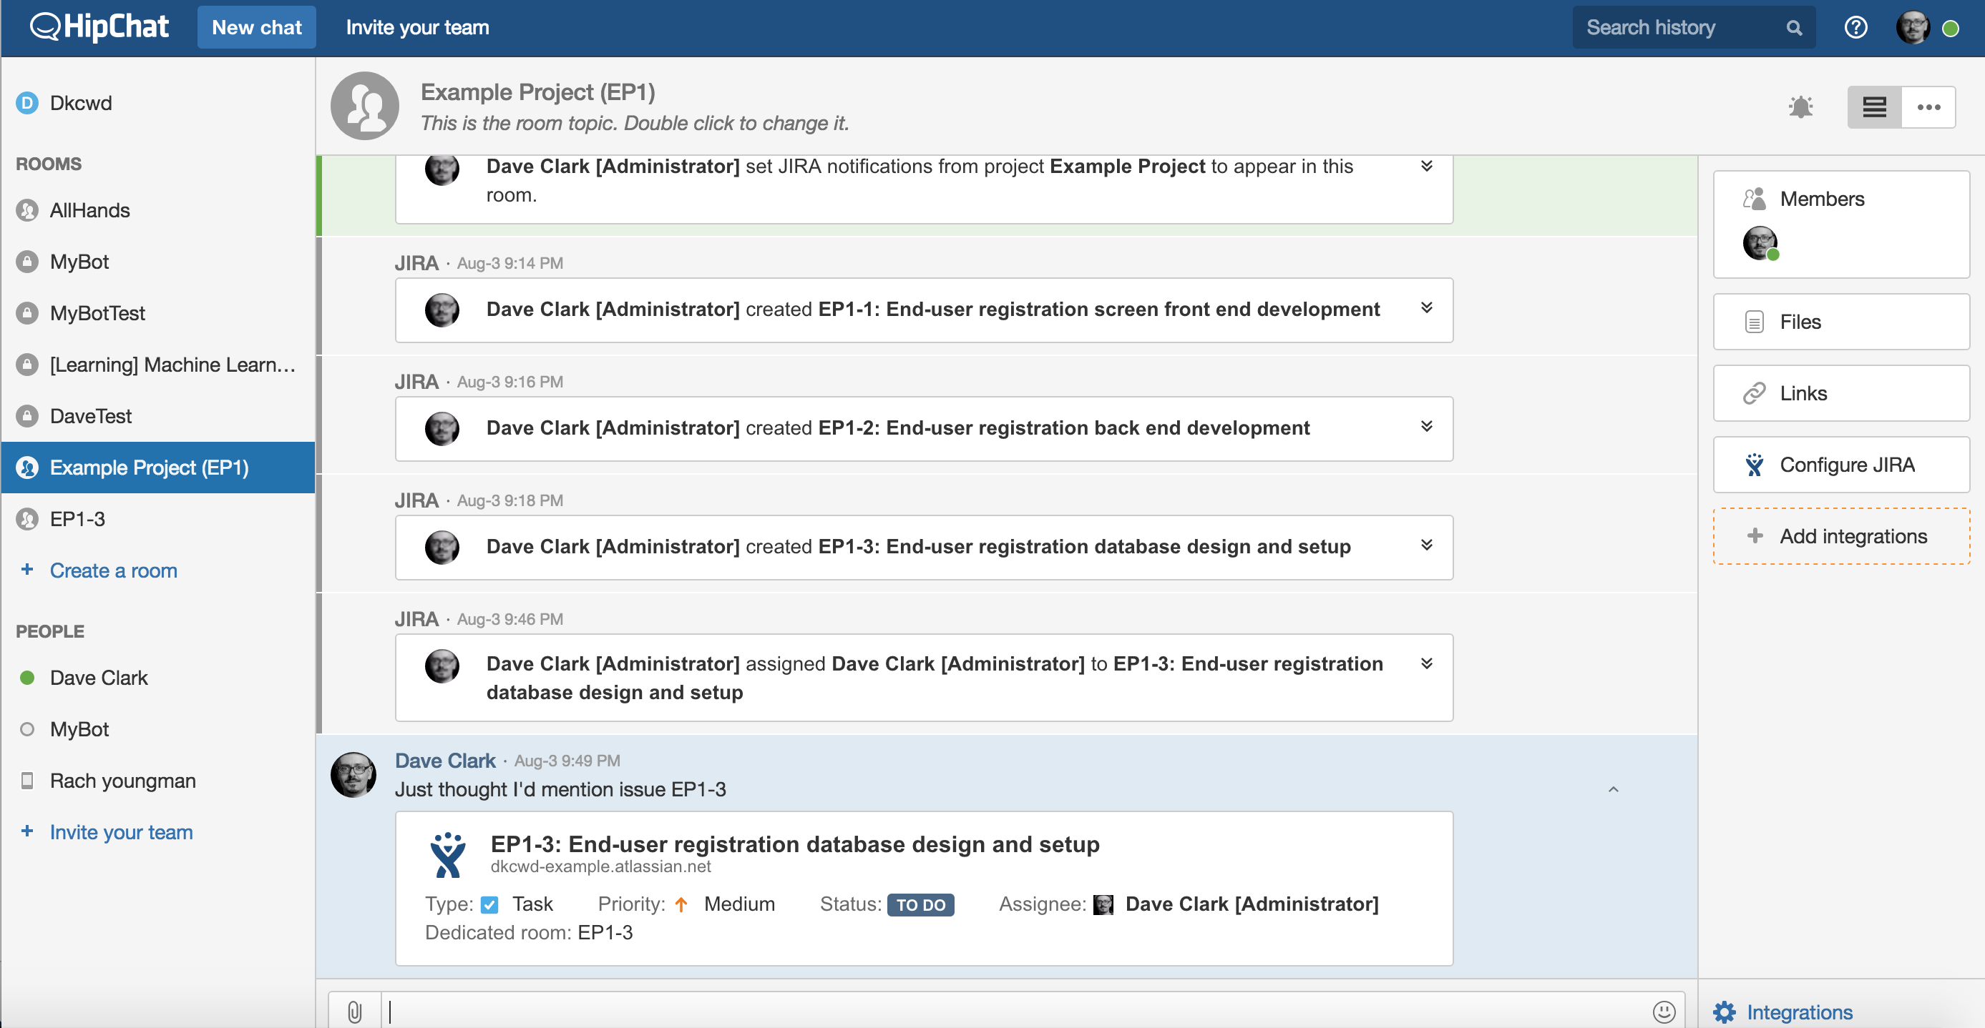
HipChat and JIRA
This room is linked to the JIRA project so any new tickets, related assignments and mentions of tickets which belong to the project will show in the room using a “card” format

Slide 29
HipChat and JIRA
You can configure a JIRA “glance” using this button. A glance is an integration feature which allows a structured custom view within HipChat

Slide 30
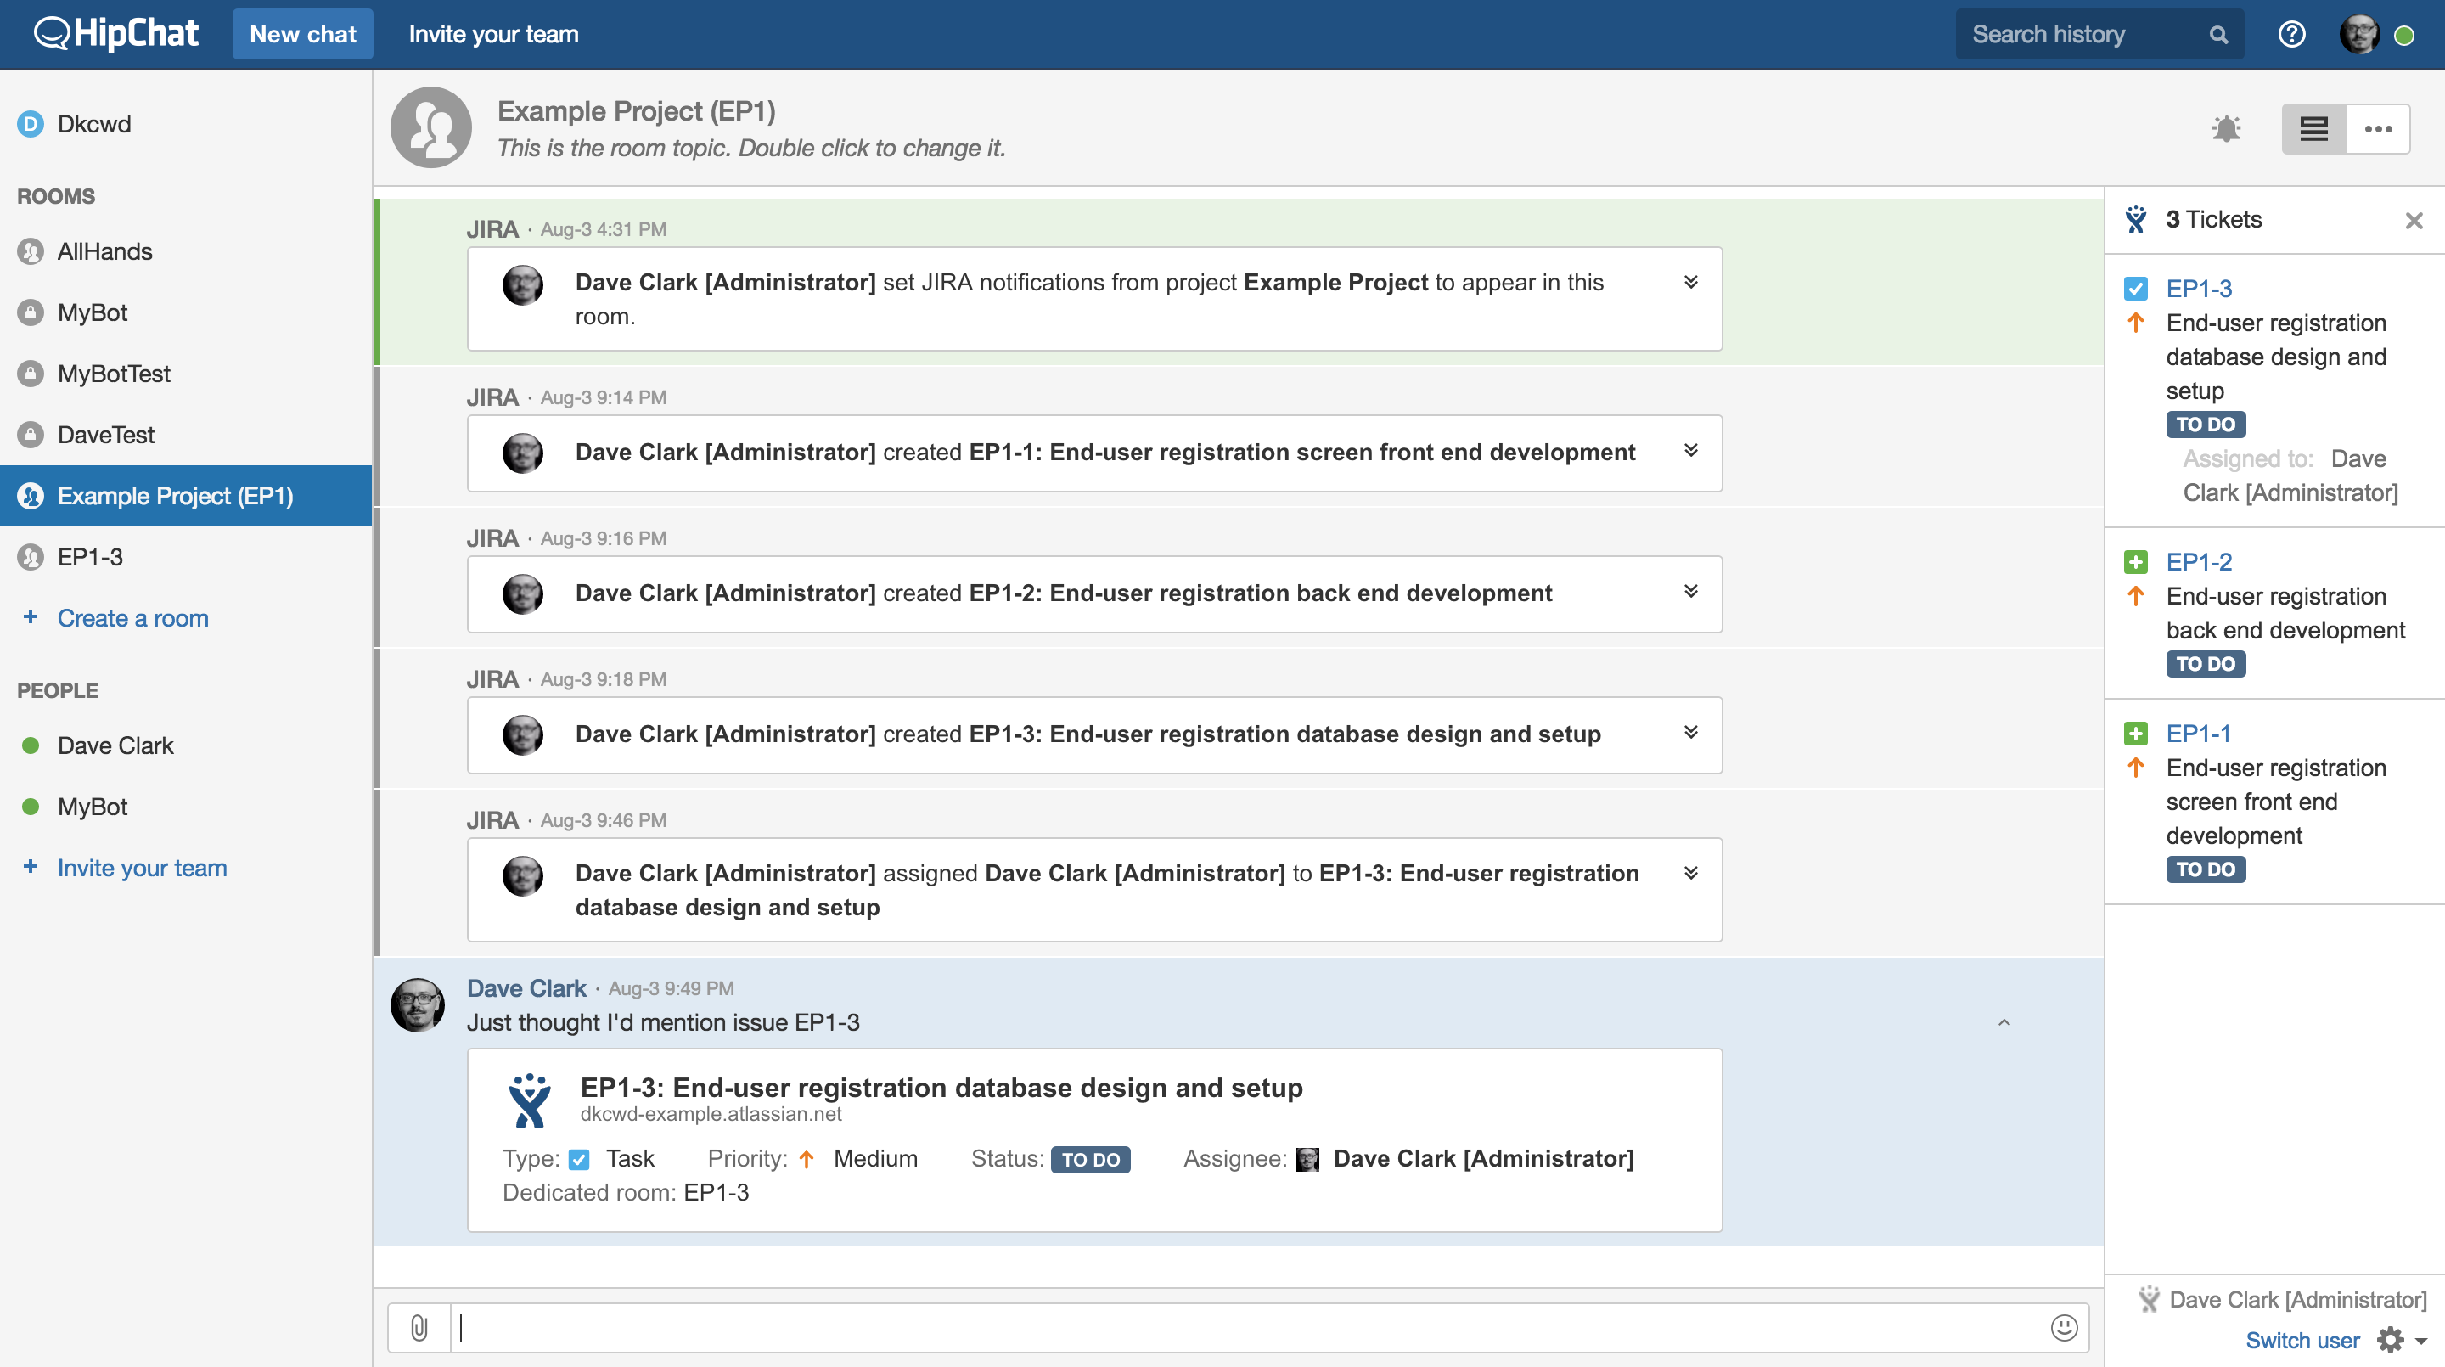
HipChat and JIRA
In this case the glance is displaying the tickets which it has been configured to show and it is straight forward to edit what you see here.

Slide 31
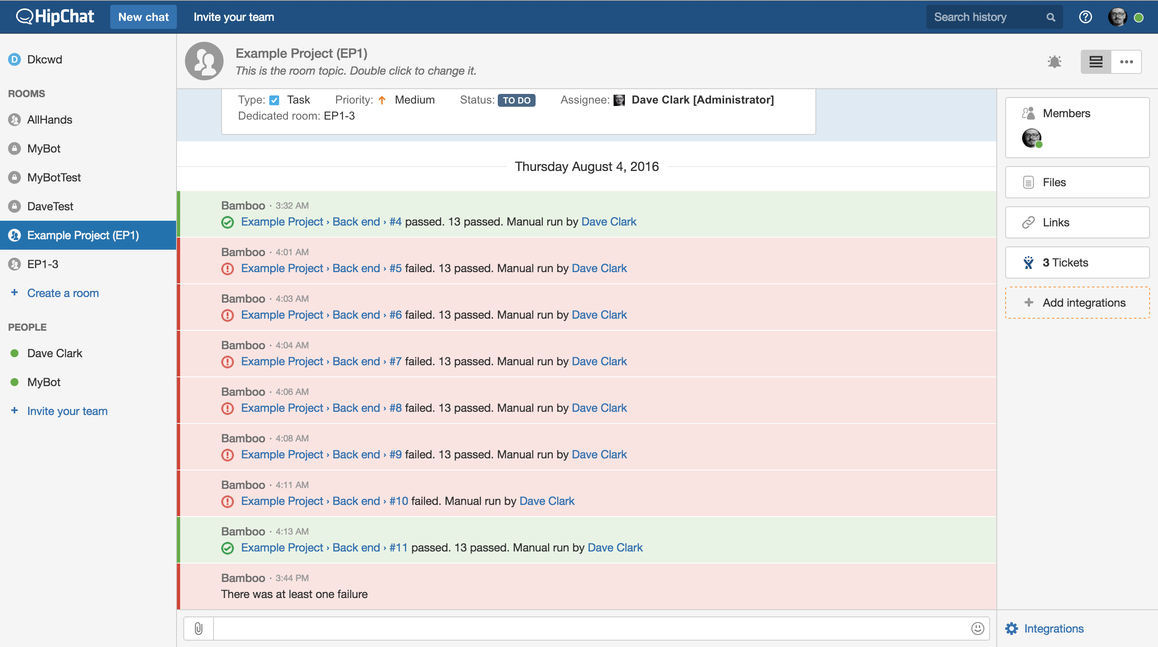
HipChat and Bamboo
Build, test and deployment statuses can be shown within HipChat. Specific users can be mentioned and you can customize notifications using the HipChat API….

Slide 32
What next?
1. Try configuring some of these integrations if you haven’t done it before
2. Work out what steps of common processes you believe would be valuable to automate using Bamboo (tip: you could automate infrastructure orchestration or run lean integration test suites)
3. Experiment with the APIs of the tools and find some opportunities to automate all the things!
And most importantly….

Slide 33
Enjoy and share what you do….
I’m on Twitter: @dkcwd
LinkedIn: https://au.linkedin.com/in/daveclarkprofile

